Slide 1
Financial Markets and Securities Session 4 Fixed Income market

Slide 2
Classes of Financial Assets
Money market
Bond market
Equity markets
Indexes
Derivative markets

Slide 3
Bond Characteristics
Bonds are debt obligations of issuers (borrowers) to bondholders (creditors)
Face or par value is the principal repaid at maturity, typically $1000
The coupon rate determines the interest payment (“coupon payments”) paid semiannually
The indenture is the contract between the issuer and the bondholder that specifies the coupon rate, maturity date, and par value
Compounding and payments
Net and Gross Price
Accrued Interest

Slide 4
U.S. Treasury Bonds
Bonds and notes may be purchased directly from the Treasury
Note maturity is 1-10 years; Bond maturity is 10-30 years
Denomination can be as small as $100, but $1,000 is more common
Bid price of 100:08 means 100 8/32 or $1002.50

Slide 5
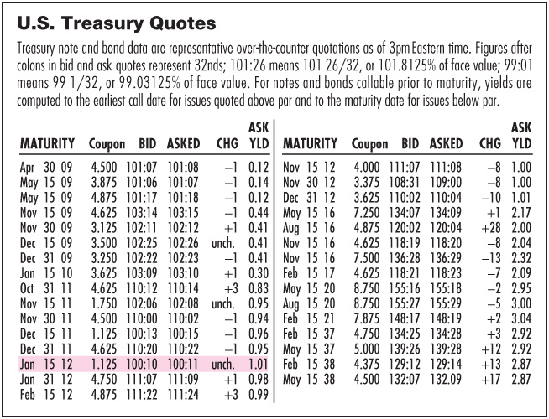
U.S. Treasuries (example)
Notes:
Percentage of the parű
Bid and ask side

Slide 6
Corporate Bonds & Debt
Most bonds are traded over the counter (OTC)
Par = $1,000
Registered versus Bearer bonds
Callable bonds
Can be repurchased before the maturity date
Convertible bonds
Can be exchanged for shares of the firm’s common stock
Puttable Bonds
Give the holder an option to retire or extend the bond
Floating-rate bonds
Have adjustable coupon rate
Notes:
U.S. bonds are registered, most bonds in the rest of the world are bearer bonds. With bearer bonds you must clip off the coupon and mail it in to get your interest as you are not a registered owner, although a broker can do this for you. With registered bonds the issuer and the issuer’s trustee knows you are the owner and you will receive your interest and principal payments automatically. Registration helps the IRS ensure that interest income is declared.
The call provision is in the favor of the bond issuer, the issuer is likely to call in the bond when interest rates have fallen. The bond will be redeemed at a price over par, but the investor will be left with reinvesting in a lower interest rate environment. The firm is not going to call the bond unless its market value would have been above the call price. Most bonds are callable after an initial call protection period of 3 to 5 years. The quid pro quo is that bond issuers will have to pay a slightly higher yield rate if the bond is callable.
Convertible bonds may be converted to common stock at the option of the bondholder. This one is in the favor of the bondholder and the conversion ‘sweetener’ may reduce the required return.
In a putable bond the bondholder has the right to put the bond back, sell it back, to the bond issuer, usually on a coupon payment date.

Slide 7
Preferred Stock
Shares characteristics of equity & fixed income
Dividends are paid in perpetuity
Nonpayment of dividends does not mean bankruptcy
Preferred dividends are paid before common
No tax break

Slide 8
Default Risk and Ratings
Financial conditions and stability is analyzed and pulbished by the Rating Agencies
Main Ratings Companies
Moody’s Investor Service
Standard & Poor’s
Fitch
Main Rating Categories
Highest rating is AAA or Aaa
Investment grade bonds are rated BBB or Baa and above
Speculative grade/junk bonds have ratings below BBB or Baa
Notes:
During the credit crisis of 2008 the spread between Treasury bonds and junk bond yields widened from 3% in 2007 to 15% at the start of 2009!

Slide 9
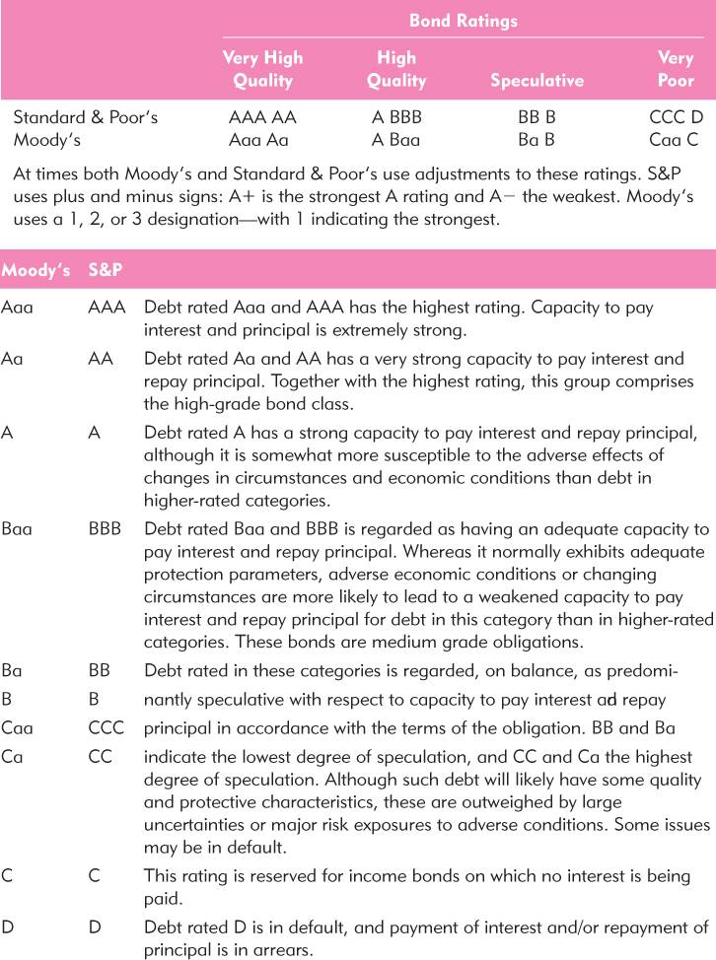
Definitions of Bond Rating Classes
Credit rating categories
Hungary's credit rating

Slide 10
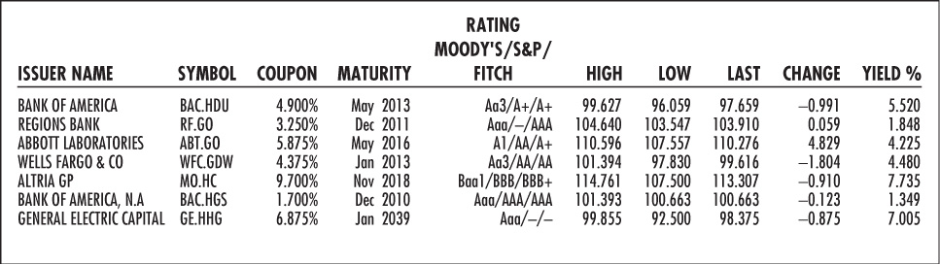
Listing of Corporate Bonds

Slide 11
Bond pricing

Slide 12
Bond Pricing
P_{B} = Price of the bond
C_{t} = Interest or coupon payments
T = Number of periods to maturity
r = Semi-annual discount rate or the semi-annual yield to maturity

Slide 13
Bond Pricing
Price of a 30 year, 8% coupon bond. Market rate of interest is 10%.

Slide 14
Bond Pricing Between Coupon Dates
The flat price or quoted price assumes the bond is purchased on a coupon payment date.
If the bond buyer purchases a bond between payment dates the buyer’s invoice price = flat price + accrued interest.

Slide 15
Bond Pricing Between Coupon Dates
A bond has a flat price of $925.30 and an annual coupon of $42.50 paid twice a year. 160 days have passed since the last coupon payment and there are 182 days separating the coupon payments. What is the bond’s invoice price?

Slide 16
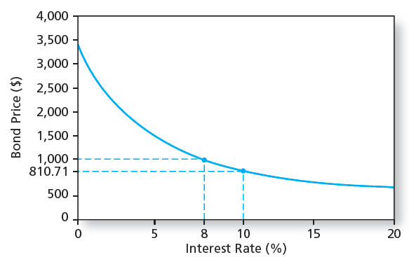
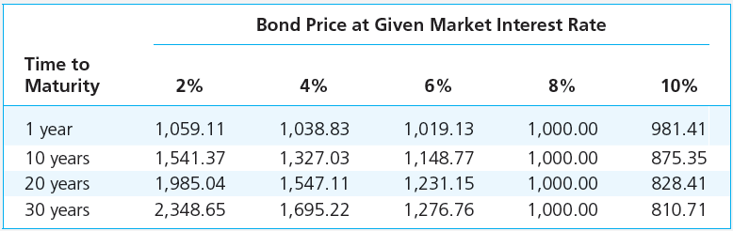
Bond Prices and Yields
Prices and yields (required rates of return) have an inverse relationship
The bond price curve is convex
The longer the maturity, the more sensitive the bond’s price to changes in market interest rates

Slide 17
Bond price over time

Slide 18
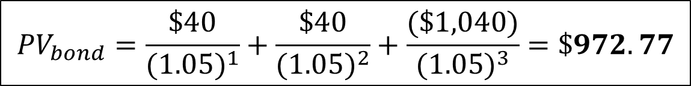
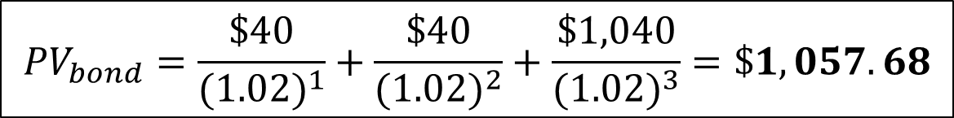
Bond Prices & Interest Rates
As interest rates change, so do bond prices.
What is the present value of a 4% coupon bond with face value $1,000 that matures in 3 years? Assume a discount rate of 5%.
What is the present value of this same bond at a discount rate of 2%?
Notes:
When the interest rate rises, the present value of the payments to be received by the bondholder falls and bond prices fall.
When the interest rate decreases, the present value of the payments to be received by the bondholder increases and bond prices rise.
Interest rate risk – The risk in bond prices due to fluctuations in interest rates.

Slide 19
Premium and Discount Bonds
Premium Bond
Coupon rate exceeds yield to maturity
Bond price will decline to par over its maturity
Discount Bond
Yield to maturity exceeds coupon rate
Bond price will increase to par over its maturity
Can you explain why these price change will occur?
Notes:
A premium bond is priced above par because the coupon rate is too high relative to what the bond is supposed to be yielding. The only way to get the expected yield down to the ytm is to have the bond priced above par. In this case, the current yield on the bond will be above the promised yield. Hence there must be a capital loss on the premium bond over the year to get the overall yield down to the promised ytm.

Slide 20
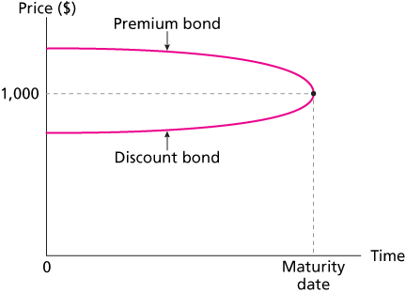
Premium/Discount Bonds over Time
Notes:
This illustrates the “Pull to Par” discussed on the prior slide.

Slide 21
YTM vs. Current Yield
Yield to Maturity
Bond’s internal rate of return
The interest rate that makes the PV of a bond’s payments equal to its price; assumes that all bond coupons can be reinvested at the YTM
Current Yield
Bond’s annual coupon payment divided by the bond price
For premium bonds
Coupon rate > Current yield > YTM
For discount bonds, relationships are reversed

Slide 22
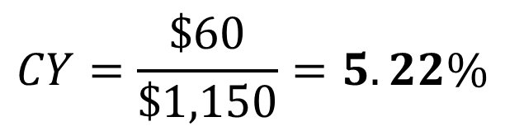
Current Yield: Example
Suppose you spend $1,150 for a $1,000 face value bond that pays a $60 annual coupon payment for 3 years.
What is the bond’s current yield?
Notes:
Current Yield – Annual coupon payments divided by bond price.

Slide 23

Yield to Maturity: Example
Suppose you spend $1,150 for a $1,000 face value bond that pays a $60 annual coupon payment for 3 years.
What is the bond’s yield to maturity?
Notes:
Note: Solve yield to maturity using a spreadsheet or a financial calculator.

Slide 24
YTM vs. HPR
YTM
HPR
It is the average return if the bond is held to maturity
Depends on coupon rate, maturity, and par value
All of these are readily observable
It is the rate of return over a particular investment period
Depends on the bond’s price at the end of the holding period, an unknown future value
Can only be forecasted

Slide 25
The yield curve

Slide 26
Term Structure of Interest Rates
Relationship between yields to maturity and maturity
Yield curve: a graph of the yields on bonds relative to the number of years to maturity
Have to be similar risk or other factors would be influencing yields
Information on expected future short-term rates can be implied from the yield curve

Slide 27
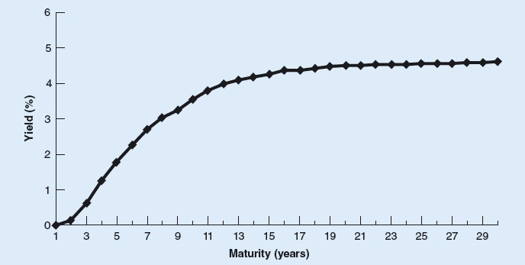
The („Normal”) Yield Curve
The yield curve represents the relationship between interest rates on bonds of different maturities, but equal credit quality.
The yield curve refers to the difference between short-term and long-term interest rates. Normally, of course, shorter-term rates are lower than the longer-term ones (investors require a premium to tie up their money for a longer period (a term premium))— such that a graph plotting interest rates as a function of maturity distinctly rises as maturity lengthens.
Notes:
Yield Curve – Plot of the relationship between bond yields to maturity and time to maturity.
The yield curve usually slopes upwards, implying that long term bonds generally earn higher yields than short-term bonds.
When interest rates are expected to rise, the yield curve is often upward sloping.
A flat yield curve indicates that investors are not being compensated for the additional risk of longer maturity bonds. This is a warning sign that an economy is under duress; investors expect slow growth, and economic indicators are sending mixed signals. As investors buy and sell bonds to flatten the yield curve, they are demonstrating through their behavior that they are worried about the outlook of the economy. As a result, they prefer to have their money tied up longer in safe investments, and demand less of a return for doing so.
A flat yield curve can develop into the dreaded “inverted” yield curve when the economic outlook is very bleak. When the yield curve inverts, it indicates tough economic times ahead. The logic goes like this: If I’m worried the economy is going to crash, I want to look for safe ways of preserving my capital. If I suspect falling equity prices, and falling interest rates, I’m going to try to lock my capital away in longer-term bonds as a way to ride out the storm. As more and more investors do this, it drives longer maturity bond prices up, and the yields down. These same investors will shy away from short-term bonds, which may have to be reinvested during the downturn. This lack of demand drives short-term treasury prices down and the yields up.

Slide 28
Treasury Yield Curves

Slide 29
Theories of the Term Structure
Expectations
Long term rates are a function of expected future short term rates
Upward slope means that the market is expecting higher future short term rates
Downward slope means that the market is expecting lower future short term rates
Liquidity Preference
Upward bias over expectations
The observed long-term rate includes a risk premium

Slide 30
Managing Bond Portfolios
McGraw-Hill/Irwin
Copyright © 2010 by The McGraw-Hill Companies, Inc. All rights reserved.
Notes:
30
Describes the financial instruments traded in primary and secondary markets.
Discusses Market indexes. Discusses options and futures.

Slide 31
Interest Rate Risk

Slide 32
Risks of Bonds
Bonds are generally less risky than stocks, but they do suffer from several types of risk:
Credit risk – Risk of default. (See ratings on next slide)
Price risk – Risk of unexpected changes in rates, causing a capital loss.
Reinvestment risk – Risk that rates will fall and you will reinvest at a lower rate.
Purchasing power risk – Risk that inflation will be higher than expected.
Liquidity risk – The risk that you will not be able to sell the bond at a price near its full value.
Foreign exchange risk – Risk that a foreign currency will decline in value, causing a decline in the value of your interest payments and principal.

Slide 33
Interest Rate Risk
Interest Rate Sensitivity
Bond prices and yields are inversely related
An increase in a bond’s yield to maturity results in a smaller price change than a decrease of equal magnitude
Long-term bonds tend to be more price sensitive than short-term bonds
Sensitivity will decrease over the time. As maturity increases, price sensitivity will be higher at a decreasing rate
Interest rate risk is inversely related to the bond’s coupon rate
Price sensitivity is inversely related to the yield to maturity at which the bond is selling

Slide 34
Duration
Duration is the term for the effective maturity of a bond
The weighted average of the times until each payment is received, with the weights proportional to the present value of the payment
Time value of money tells us we must calculate the present value of each of the five zero coupon bonds to construct an average.
We then need to take the present value of each zero and divide it by the price of the coupon bond. This tells us what percentage of our money we get back each year.
We can now construct the weighted average of the times until each payment is received.

Slide 35
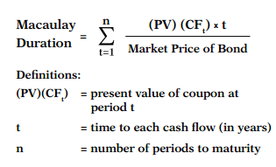
Calculating the duration of a 9% coupon, 8% ytm, 4 year annual payment bond priced at $1033.12,
90
90
90
1090
83.33
77.16
71.45
$801.18
8.06%
7.47%
6.92%
77.55%
0.0806
0.1494
0.2076
3.1020
$1,033.12
100.00%
3.5396 yrs
Duration = 3.5396 years

Slide 36
Duration Formula
W_{t} = Weight of time t, present value of the cash flow earned in time t as a percent of the amount invested
CF_{t} = Cash Flow in Time t, coupon in all periods except terminal period when it is the sum of the coupon and the principal
ytm = yield to maturity; Price = bond’s price
Dur = Duration
Notes:
The amount invested is the price

Slide 37
More on Duration
Duration increases with maturity
A higher coupon results in a lower duration
Duration is shorter than maturity for all bonds except zero coupon bonds
Duration is equal to maturity for zero coupon bonds
All else equal, duration is shorter at higher interest rates

Slide 38
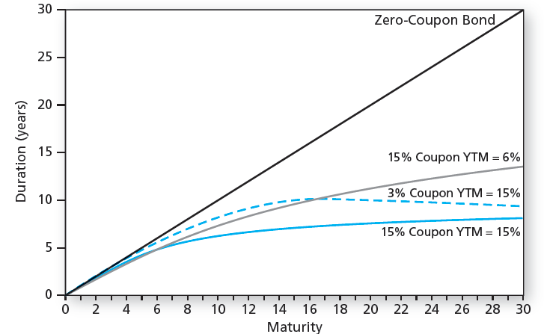
Bond Duration vs Maturity

Slide 39
Duration/Price Relationship
Price change is proportional to duration and not to maturity
ΔP/P = -D x [Δy / (1+y)]
D* = modified duration
D* = D / (1+y)
ΔP/P = - D* x Δy
D = Duration
Notes:
The minus sign in this equation reminds us that if interest rates go up, prices go down and vice versa.
Although the text simplifies this you have to be careful using modified duration. It is used for instruments that have non-annual cash flows as follows: “Modified duration” = Duration_{Mod}
Purpose: For bonds & loans with non-annual payments
Duration_{Mod} = Duration_{Annual} / (1 + r_{period}); where r_{period} = periodic interest rate, typically semiannual for a bond
The predicted price change using modified duration is
%ΔP_{Pr}= -Duration_{Mod} * Δr_{Annual} ; Notice using modified duration allows one to plug in the annual rate change rather than the change in semi-annual rates.

Slide 40
Thank you for the attention!
Any Questions?

